Slide 1
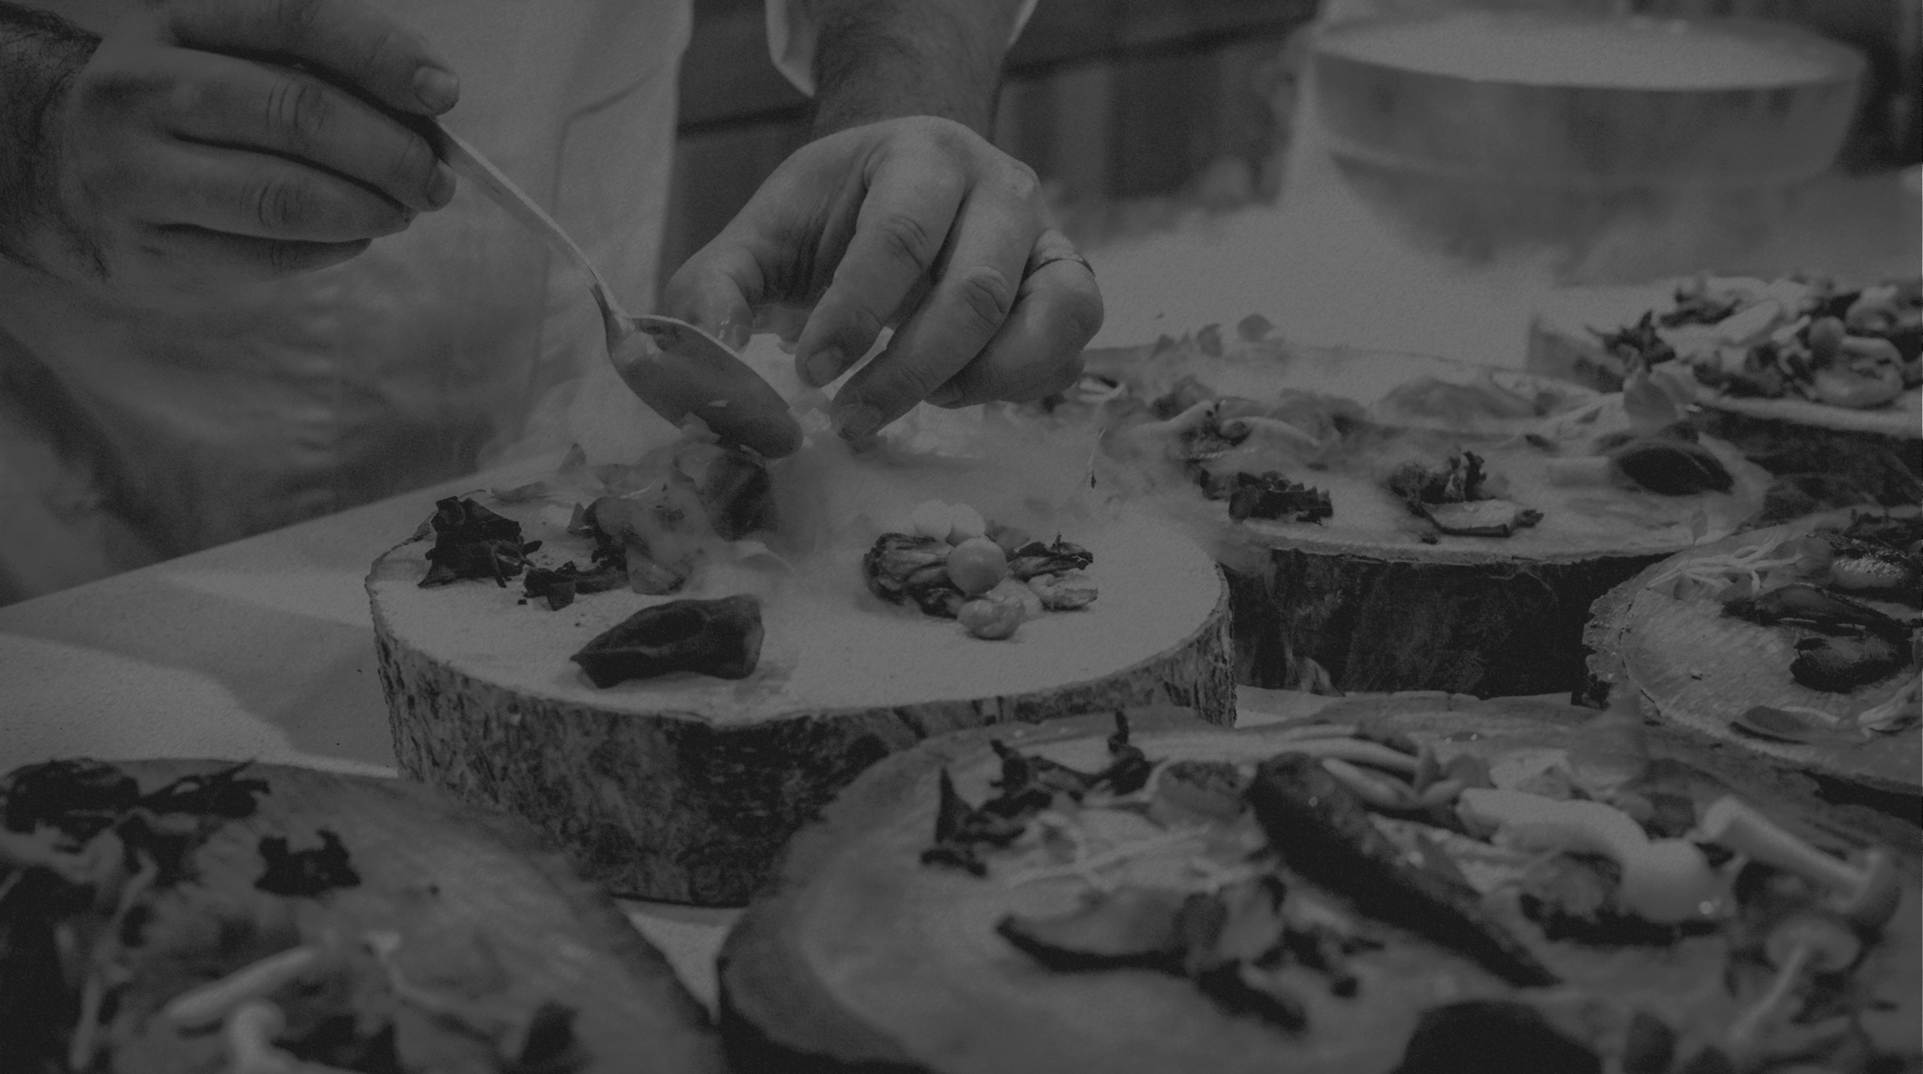
iOrder
BY
MICILLO SIMONE
PERROTTA DAVIDE
LANZUISE FABRIZIO

Slide 2

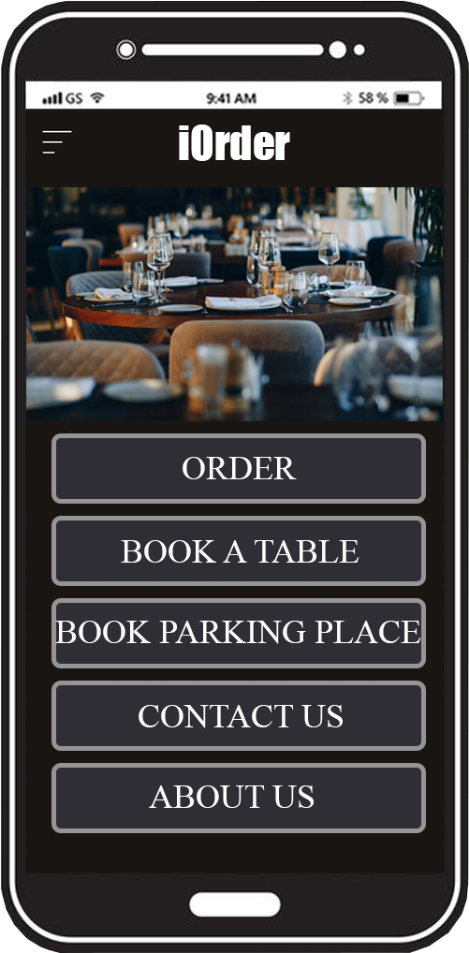
What’s iOrder?
The objectives
iOrder is a platform for the organization
of catering activities;
It’s completely dedicated to the customers;
It offers different services aimed
to improve the customer experience.
1

Slide 3
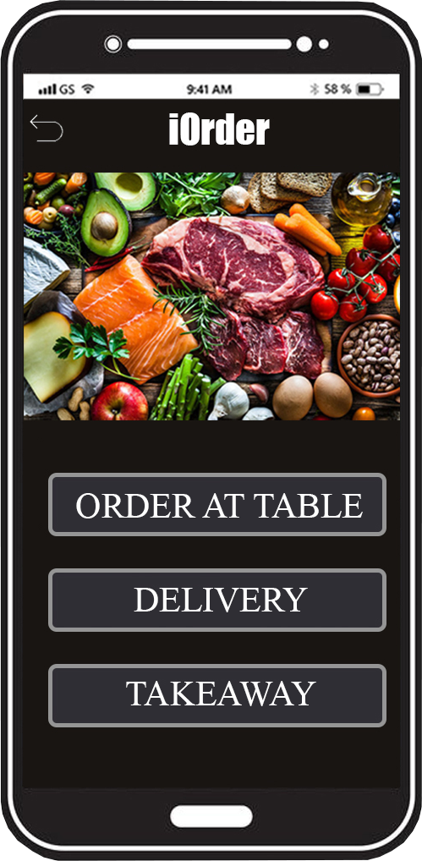
What can iOrder do?
The Features
Order
AT THE TABLE
TAKEAWAY
DELIVERY (with its estimated time)
2

Slide 4
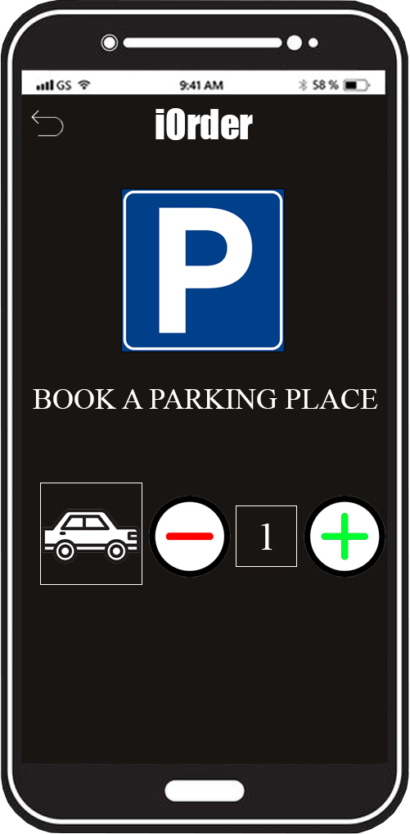
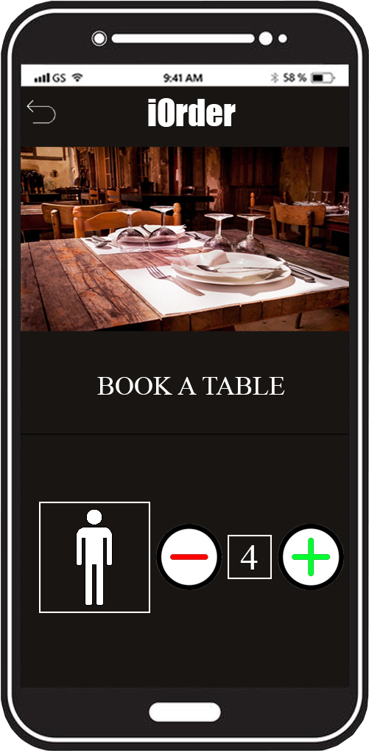

What iOrder can do?
The Features
Booking
TABLE AT RESTAURANT
3

Slide 5
Home(Fabrizio Lanzuise)
The Features
At the beginning there is the main page, which is useful for customers because they can see all that is available in the restaurant. The navigation bar has a drop-down menu on the left from which all the visible pages can be reached, while on the right there is the cart to view everything you want to order.
3

Slide 6
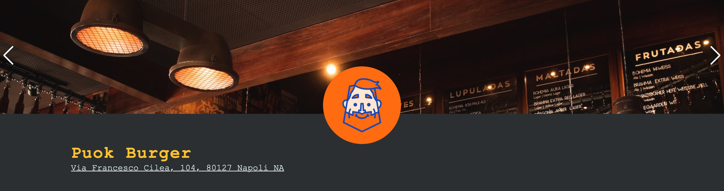
Home
The Features
Then you can find a section of photos of the restaurant; the logo with also an address.
3

Slide 7
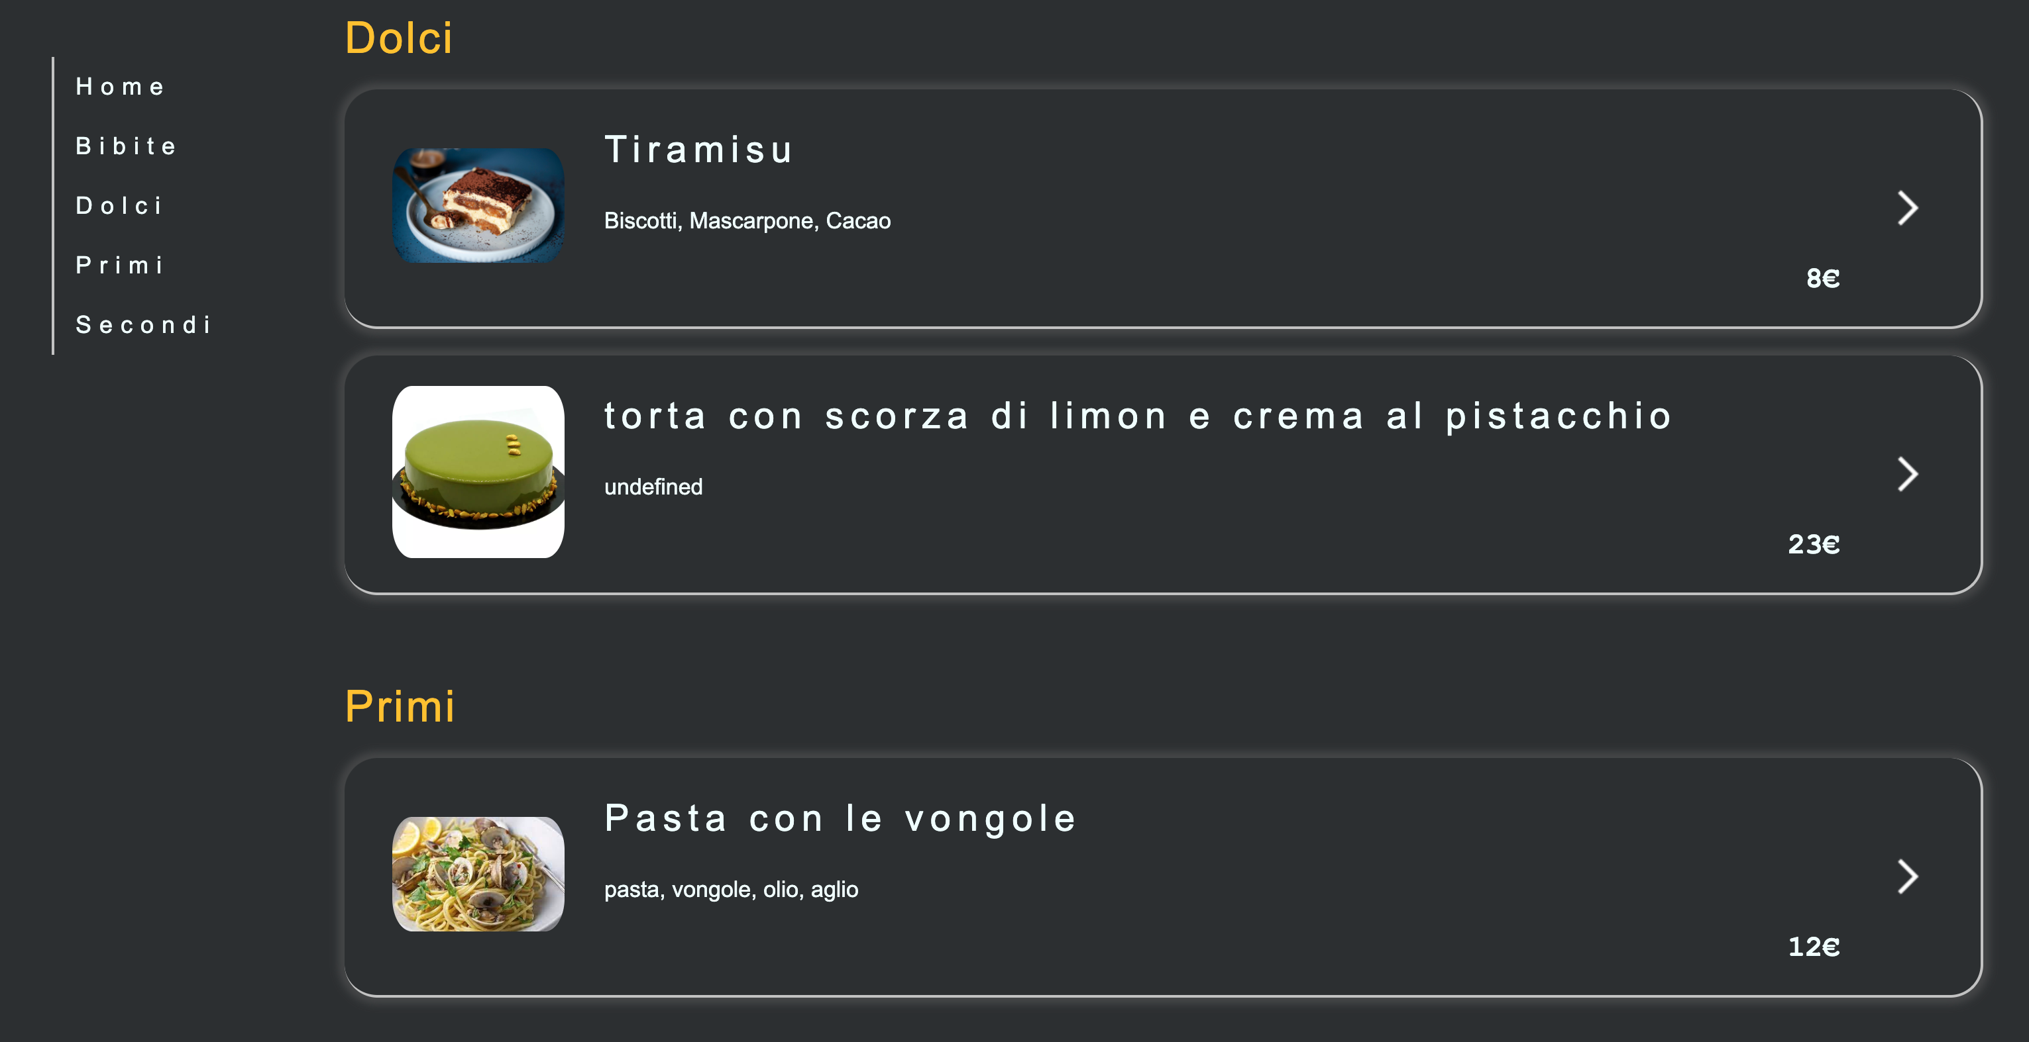
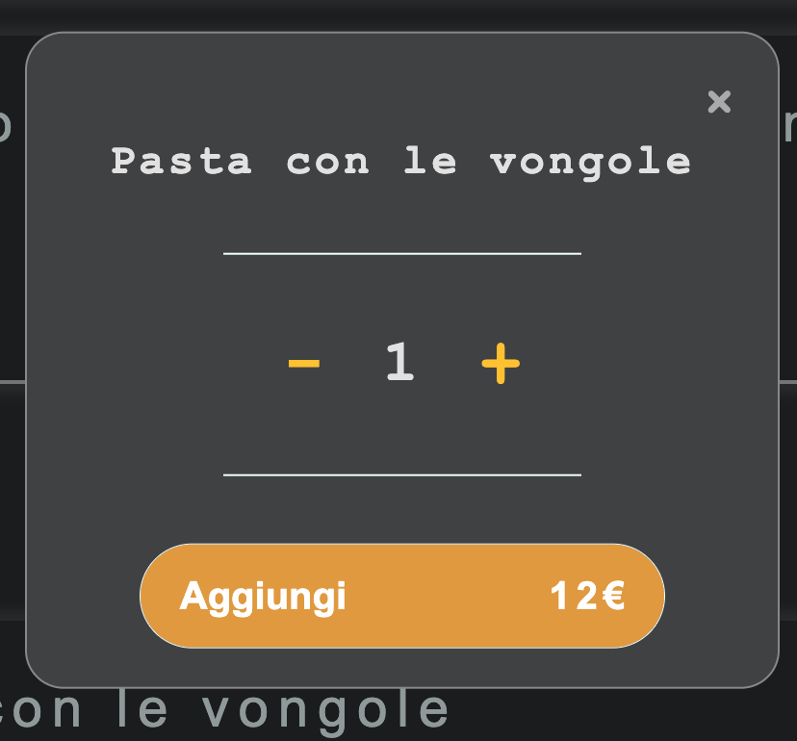
Home
The Features
The page continues with the presentation of the entire restaurant menu with a fixed sidebar, from which you can reach the various elements on the page. Each section has a box that contains the name of the dish, the description and the price and by clicking a pop-up is shown that allows the customer to decide the quantity he wants and add it to the cart.
3

Slide 8
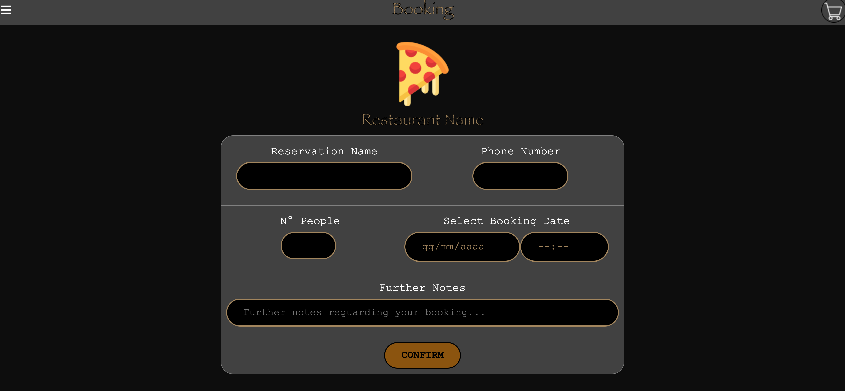
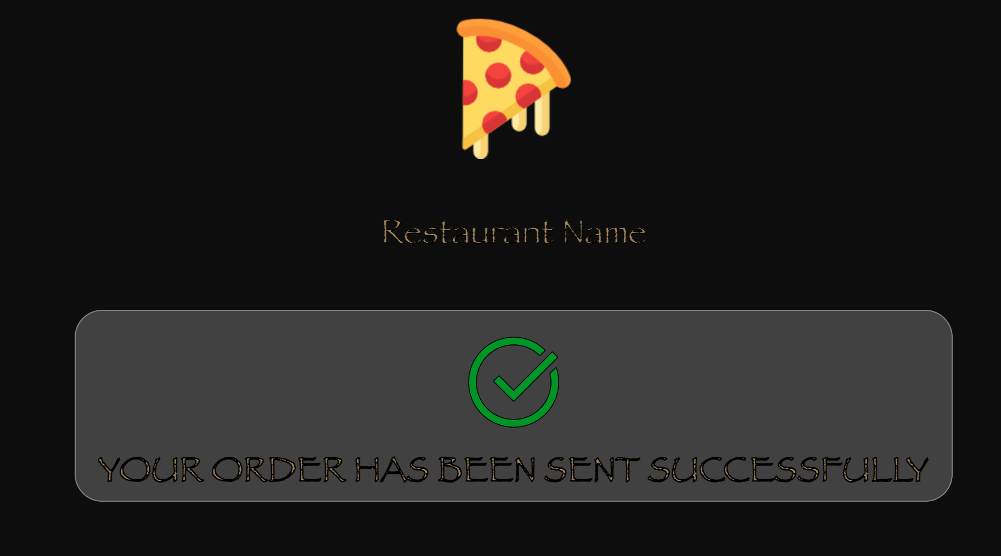
Booking Section(Simone Micillo)
The Features
In the booking section it is possible to book a seat at the table, entering name, telephone number, number of people and the desired date. At the end, when you press the confirm button, if there are seats available in the restaurant for the day chosen, the booking is successful, otherwise no.
3

Slide 9
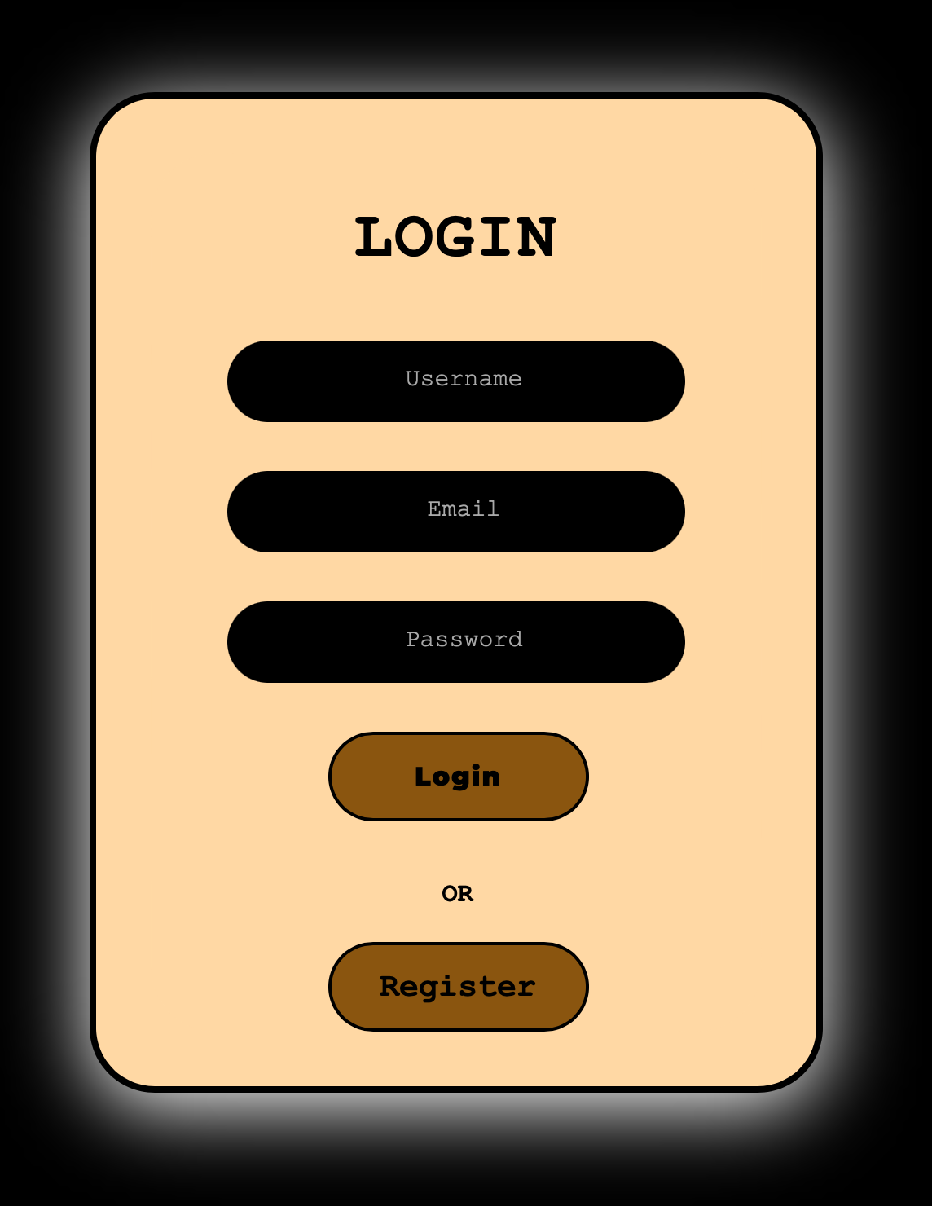
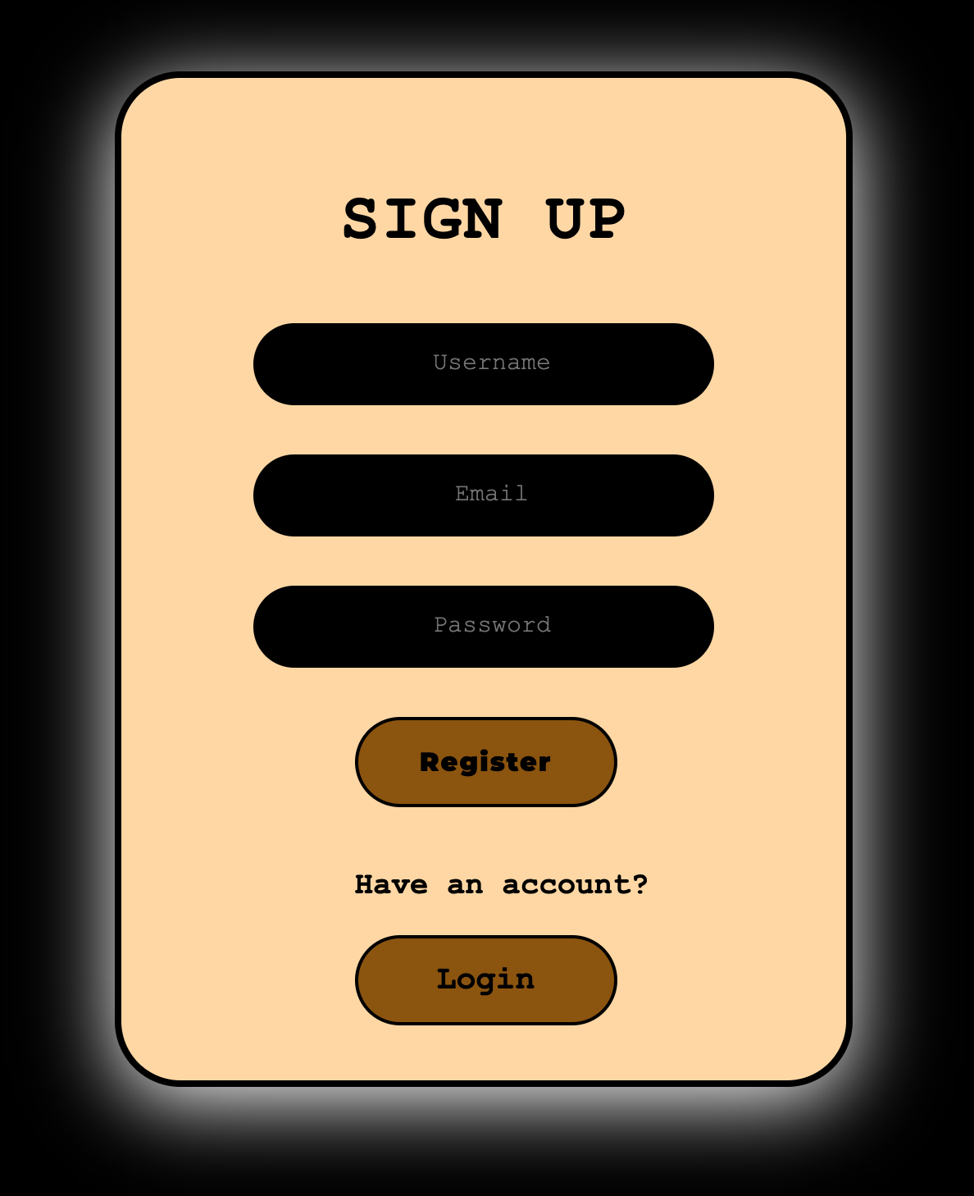
Login/Sign Up Session for customers
The Features
This section is dedicated to customer’s login,
With email and password firebase’s auth.
3

Slide 10
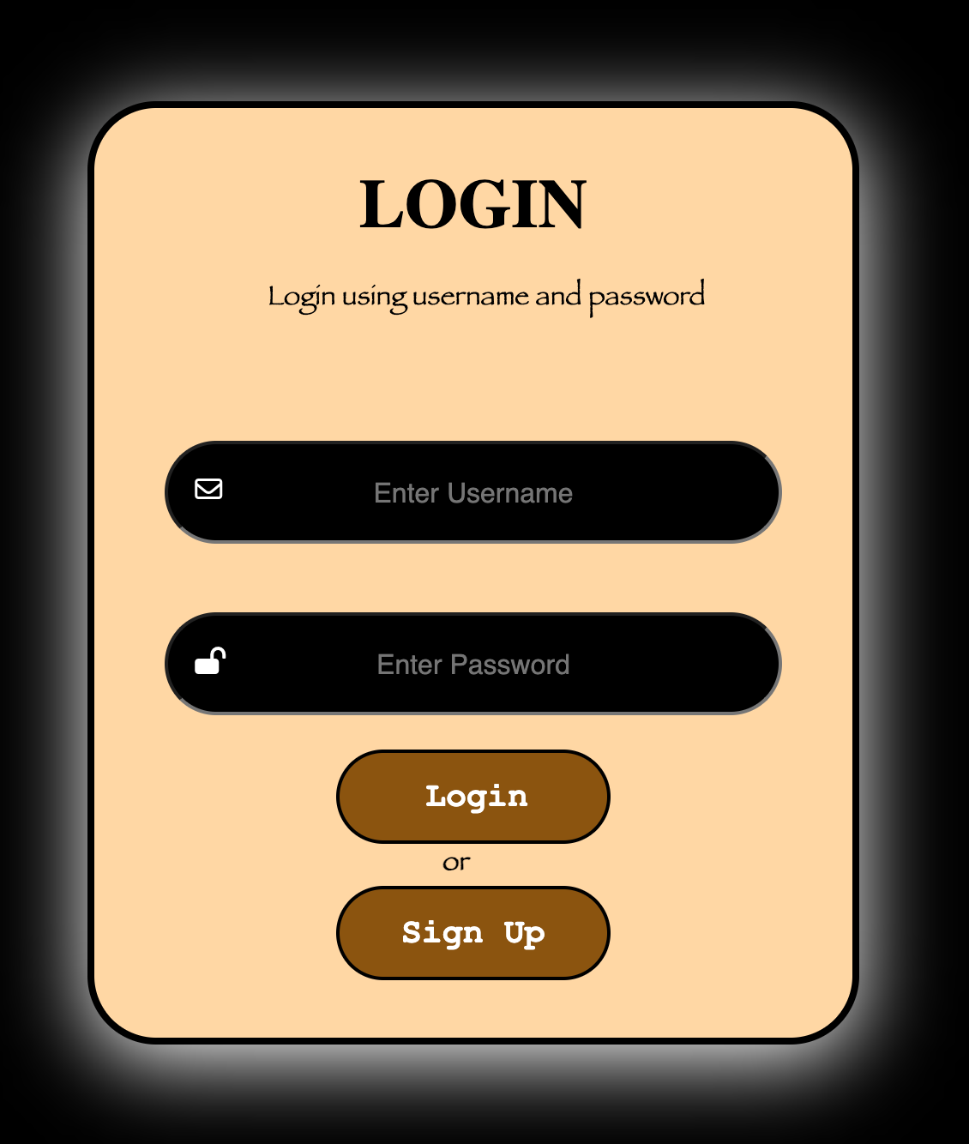
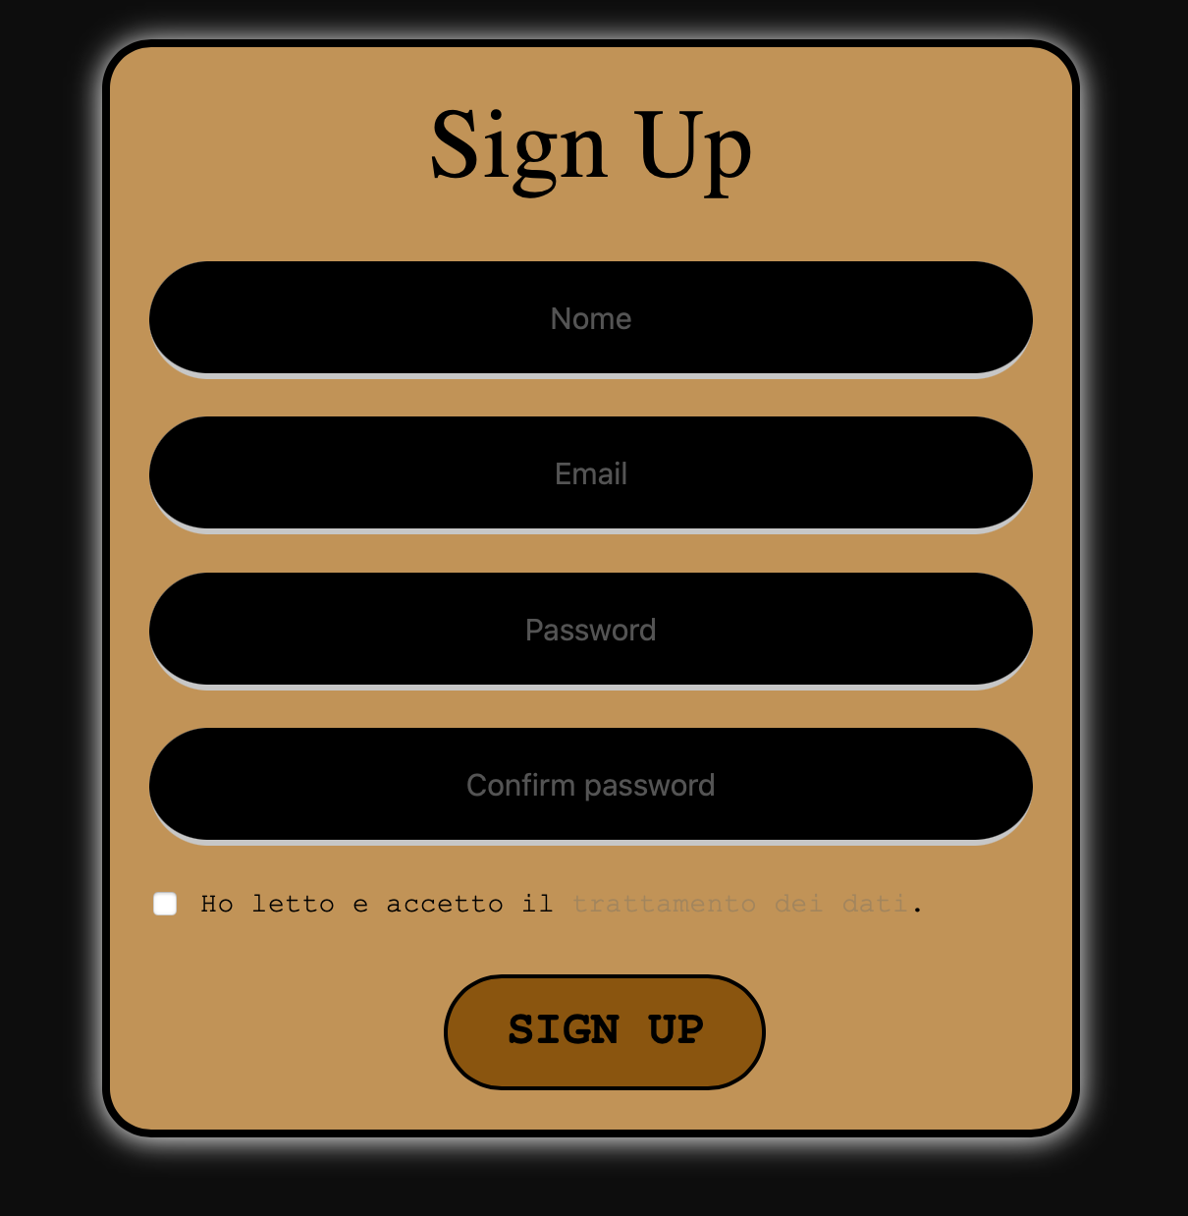
Login/Sign Up Session for the owner
The Features
This section is dedicated to customer’s login,
With email and password firebase’s auth.
3

Slide 11
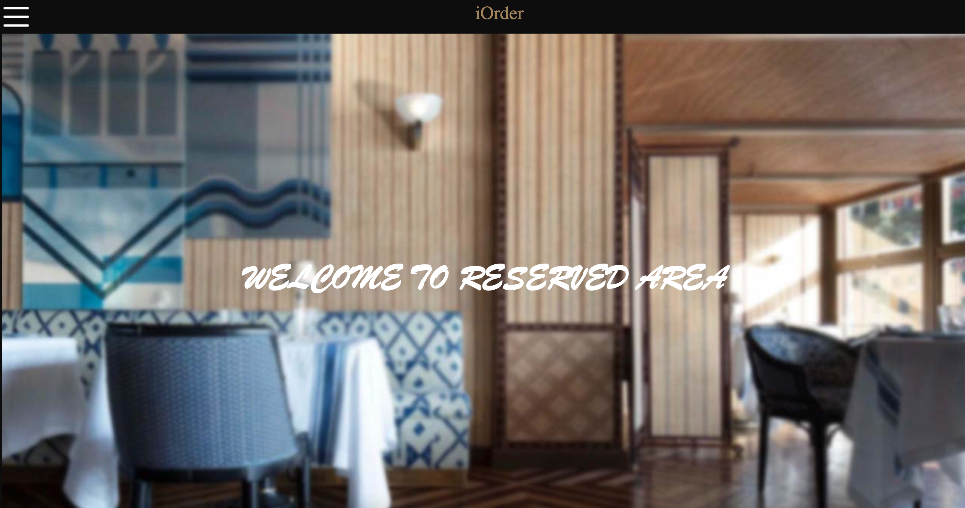
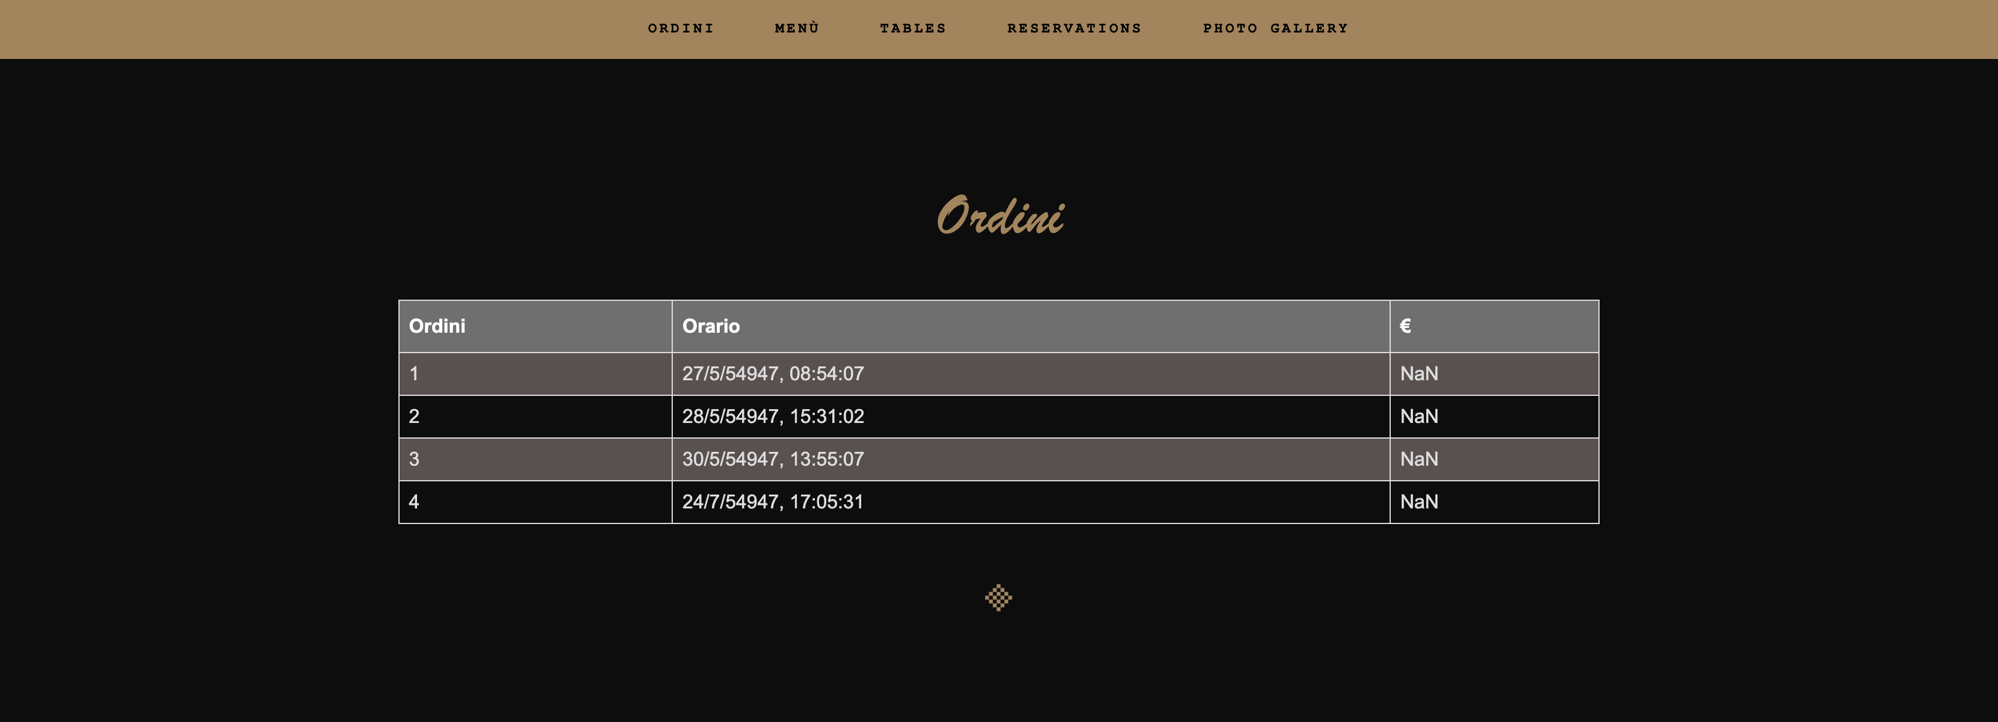
Reserved Area(Davide Perrotta)
The Features
The Reserved Area section is completely dedicated to the business owner. It comes with a section dedicated to all the orders made for a specific time and the price paid.
3

Slide 12
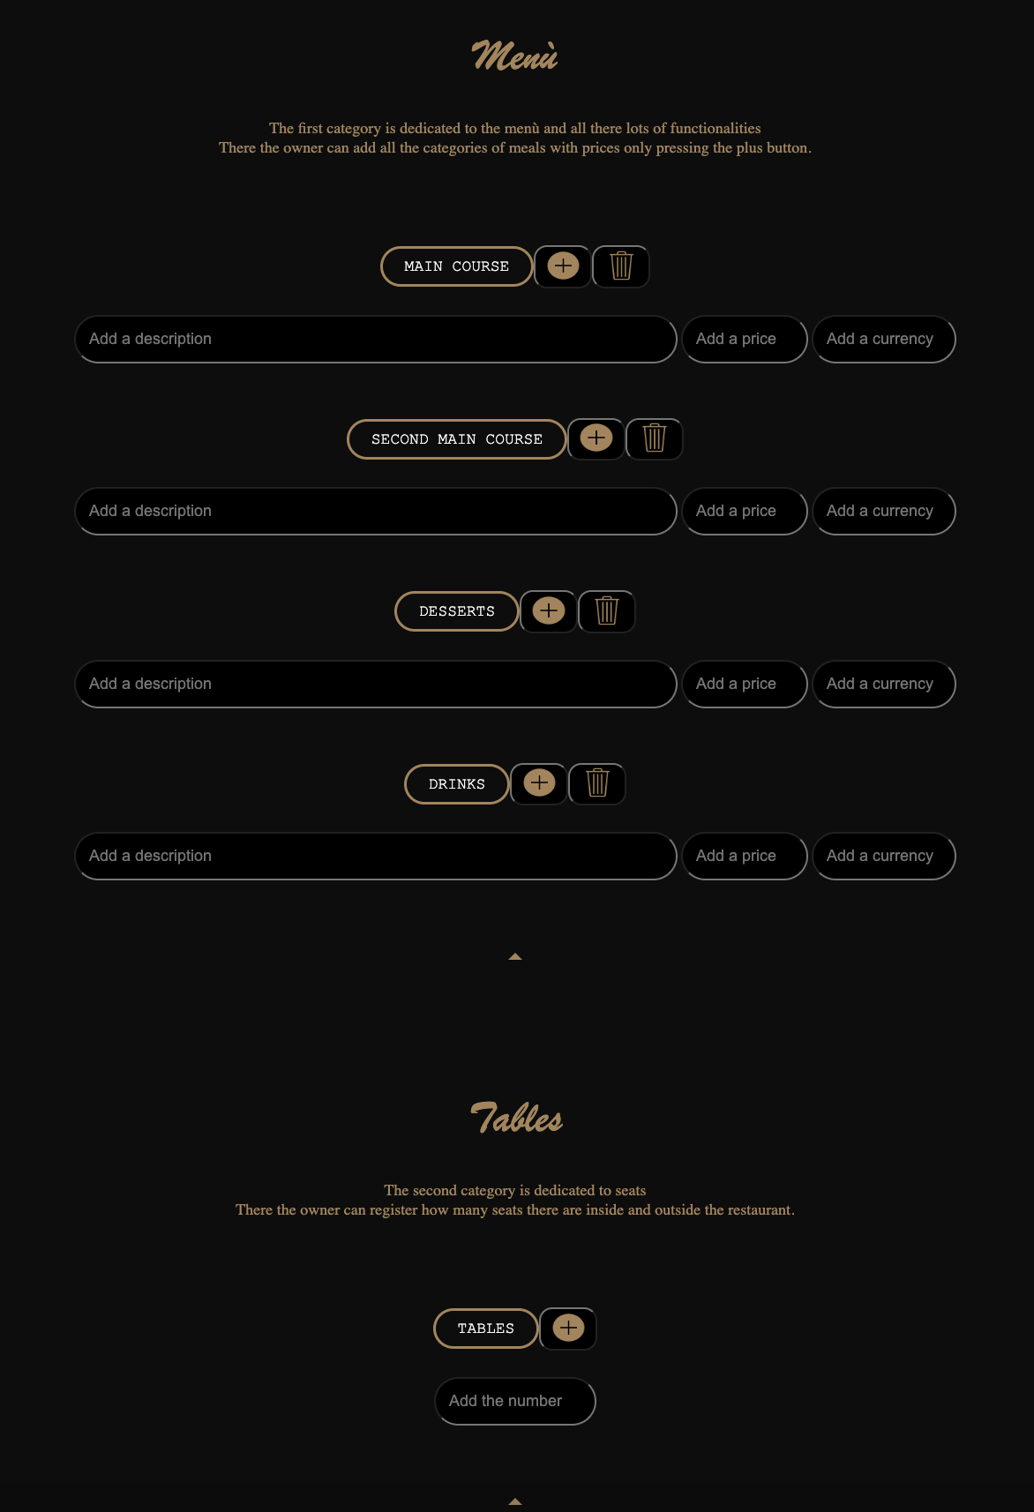
Reserved Area
The Features
Then move on to the section dedicated to the menu, where the owner can add or remove an item from the menu. The quantity of tables in the restaurant can be changed by simply entering the number of tables and pressing the button.
3

Slide 13
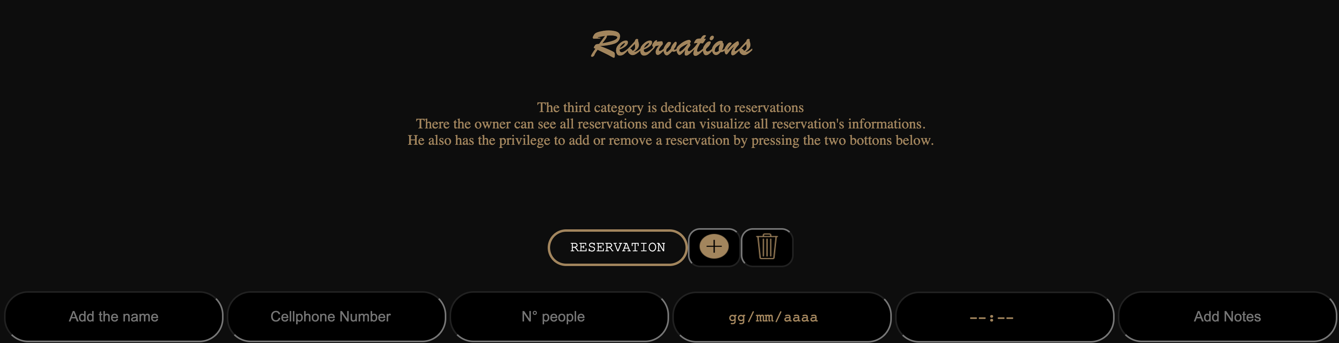
Reserved Area
The Features
The Reservation section is dedicated to adding or deleting a reservation.
3

Slide 14



Languages
Used
The languages that have been used are HTML5, CSS and JAVASCRIPT. The database used is FIREBASE.
3

